Slide 1
Machine Learning Decision Trees
IIIT Sri City

Slide 2
Nominal Data
So far we consider patterns to be represented by feature vectors of real or integer values.
Easy to come up with a distance (similarity) measure by using a variety of mathematical norms.
What happens if features are not numbers?
May not have a numerical representation
Distance measures might not make sense
Credits: Machine Learning, UCSB

Slide 3
Nominal Data: Examples
Consider the use of information about teeth in the classification of fish and sea mammals.
E.g.:
Some teeth are small and fine (as in baleen whales) for straining tiny prey from the sea. Others (as in sharks) coming in multiple rows.
Consider describing a piece of fruit by the four properties of color, texture, taste and smell.
color = red, texture = shiny,
taste = sweet and size = small
Another common approach is to describe the pattern by a variable length string of nominal attributes, such as sequence of base pairs string in a segment of DNA,
E.g.: “AGCTTCAGATTCCA.”
Credits: Pattern Classification, Duda Hart

Slide 4
How to use this data for classification/regression?
How can we best use such nominal data for classification?
Most importantly, how can we efficiently learn categories using such non-metric data?
If there is structure in strings, how can it be represented?
Credits: Machine Learning, UCSB

Slide 5
How to use this data for classification/regression?
Visualizing using n-dimensional space might be difficult how to map, say, smell, onto an axis?
There might only be few discrete values (an article is highly interesting, somewhat interesting, not interesting, etc.)
Even though that helps, do remember you cannot take distance measure in that space
(e.g., Euclidean distance in r-g-b color space does not correspond to human perception of color)
Credits: Machine Learning, UCSB

Slide 6
Decision Trees
A classification based on a sequence of questions on
A particular feature (E.g., is the fruit sweet or not?) or
A particular set of features (E.g., is this article relevant and interesting?)
Answer can be either
Yes/no
Choice (relevant & interesting, interesting but not relevant, relevant but not interesting, etc.)
Usual a finite number of discrete values
Credits: Machine Learning, UCSB

Slide 7
Decision Trees
It is natural and intuitive to classify a pattern through a sequence of questions, in which the next question asked depends on the answer to the current question.
This approach is particularly useful for non-metric data, since all of the questions can be asked in a “yes/no” or “true/false” or “value(property) ∈ set of values” style that does not require any notion of metric.
Such sequence of questions is displayed in a directed decision tree or simply tree.
Credits: Pattern Classification, Duda hart

Slide 8
Decision Trees
Such sequence of questions is displayed in a directed decision tree or simply tree.
Where by convention root node the first or root node is displayed at the top.
Root is connected by successive (directional) links or branches to other nodes.
These are similarly connected until we reach terminal or leaf nodes, which have no further links.
Credits: Pattern Classification, Duda hart

Slide 9
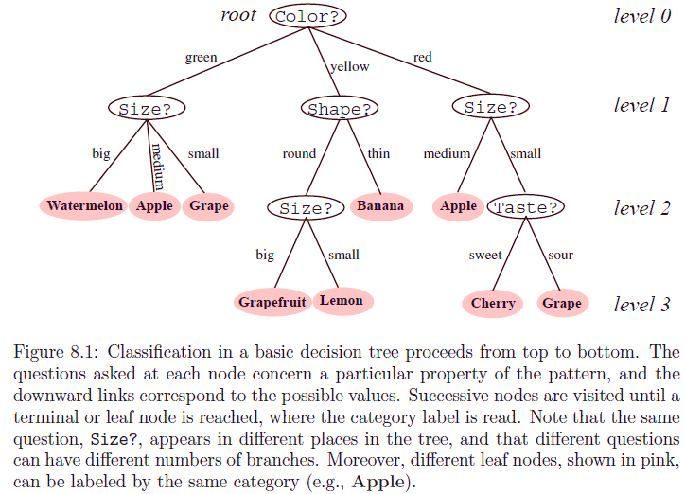
Decision Tree
Credits: Pattern Classification, Duda hart

Slide 10
DT: How they are used for classification?
The classification of a particular pattern begins at the root node, which asks for the value of a particular property of the pattern.
The different links from the root node correspond to the different possible values.
Based on the answer we follow the appropriate link to a subsequent or descendent node.
In the trees, the links must be mutually distinct and exhaustive, i.e., one and only one link will be followed.

Slide 11
DT: How they are used for classification?
The next step is to make the decision at the sub-tree appropriate subsequent node, which can be considered the root of a sub-tree.
We continue this way until we reach a leaf node, which has no further question.
Each leaf node bears a category label and the test pattern is assigned the category of the leaf node reached.

Slide 12
Creation of a Decision Tree
Use supervised learning
Samples with tagged label (just like before)
Process
Number of splits
Query selection
Rule for stopping splitting and pruning
Rule for labelling the leaves
Variable combination and missing data
Credits: Machine Learning, UCSB

Slide 13
Number of splits
Each decision outcome at a node is called a split, since it corresponds to splitting a subset of the training data.
The root node splits the full training set; each successive decision splits a proper subset of the data.
The number of splits at a node is closely related to which property need to be tested and specifying which particular split will be made at a node.
The number of links descending from a node is sometimes called branching the node’s branching factor or branching ratio, denoted B.

Slide 14
Binary vs Multi-way Splits
Binary vs. Multi-way
Can always make a multi-way split into binary splits
Fruit Color
Fruit Color=yellow
yes
no
Fruit Color=green
green
red
yellow
yellow
yes
no
green
red

Slide 15
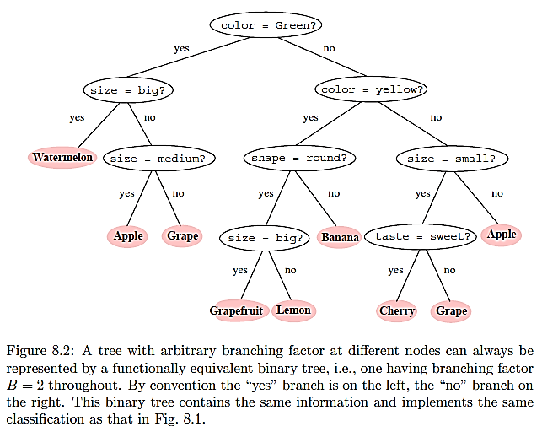
Credits: Pattern Classification, Duda hart

Slide 16
Test selection
If a feature is an ordered variable,
we might ask is x>c, for some c.
If a feature is a category, we might ask is x in a particular category
Yes sends samples to left and no sends samples to right
Simple rectangular partitions of the feature space
More complicated ones: is x>0.5 & y<0.3
Credits: Machine Learning, UCSB

Slide 17
Test selection
The fundamental principle underlying tree creation is that of simplicity: we prefer decisions that lead to a simple, compact tree with few nodes.
This is a version of Occam’s razor, that the simplest model that explains data is the one to be preferred.
“Occam's razor is the problem-solving principle that "entities should not be multiplied without necessity", or more simply, the simplest explanation is usually the right one.“
To this end, we seek a property test T at each node N that makes the purity data reaching the immediate descendent nodes as “pure” as possible.

Slide 18

Decision boundary
For example, suppose that the test at each node has the form “is x_{i} ≤ x_{i}s?” This leads to hyperplane decision boundaries that are perpendicular to the coordinate axes, and to decision regions of the form illustrated in Fig.

Slide 19

Criteria for Splitting
Intuitively, to make the populations of the samples in the two children nodes purer than the parent node
What do you mean by pure?
In formalizing this notion, it turns out to be more convenient to define the impurity, rather than purity.
General formulation
At node n, with k classes
Impurity depends on probabilities of samples at that node being in a certain class
Credits: Machine Learning, UCSB

Slide 20
Impurity
Several different mathematical measures of impurity have been proposed, all of which have basically the same behaviour.
Entropy Impurity
Variance Impurity
Gini Impurity
Misclassification impurity

